Slide 1
Computer Networking
7.3 WiFi: 802.11 Wireless LAN
7.3.1 802.11 Wireless LAN Architecture

Slide 2
GROUP MEMBERS:
Nimra Iqbal 2021-SE-31
Mohsina Mudassir 2021-SE-35

Slide 3
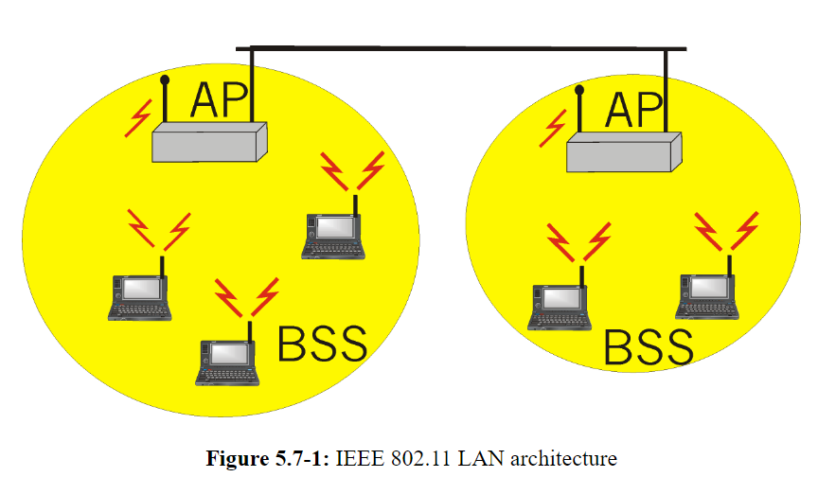
What is Wireless LAN?
“A wireless LAN or WLAN is a wireless local area network that uses radio waves as its carrier.”

Slide 4
802.11 Wireless LAN
802.11 is a set of standards developed by IEEE for implementing wireless local area networking (WLAN) communication.
Commonly referred to as Wi-Fi.
Radio waves as medium.
70m range.
802.11 b, g, n, ac, ax are successive generations of 802.11.

Slide 5
IEEE STANDARDS FOR 802.11 WIRELESS LANs
Standard | Year released | Speed | Range | Frequency
802.11 b | 1999 | 11 Mbps | 30 m | 2.4 Ghz
802.11 g | 2003 | 54 Mbps | 30m | 2.4 Ghz
802.11 n (WiFi:4) | 2009 | 600 Mbps | 70m | 2.4, 5 Ghz
802.11 ac (WiFi:5) | 2013 | 3.47 Gbps | 70m | 5 Ghz
802.11 ax (WiFi:6) | 2020 | 14 Gbps | 70m | 2.4, 5Ghz
802.11 af | 2014 | 35-560 Mbps | 1km | 54-790 Mhz
802.11 ah | 2017 | 347 Mbps | 1km | 900 Mhz

Slide 6
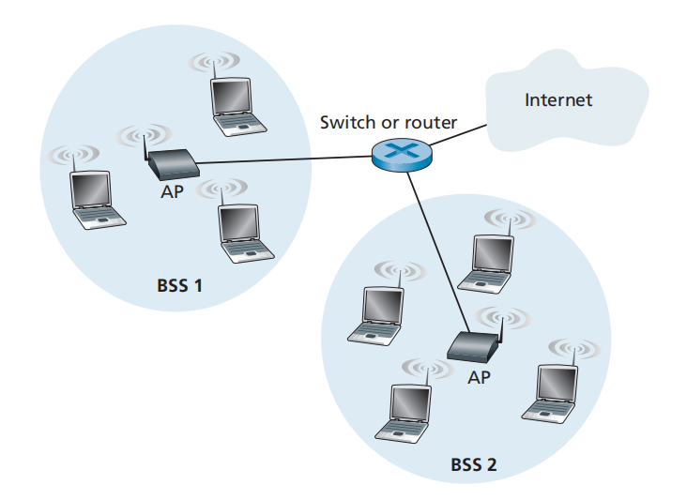
802.11 Wireless LAN Architecture

Slide 7
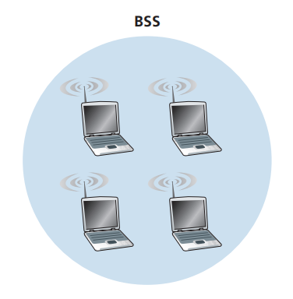
Basic Service Set (BSS)
A fundamental building block of 802.11.
Contains of one or more wireless stations and a central “base station” called Access Point (AP).

Slide 8
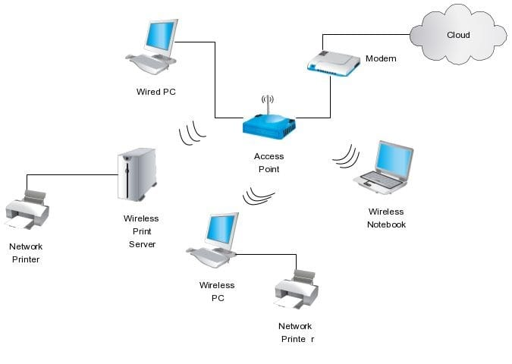
Access Point (AP)
A networking hardware device that allows a Wi-Fi device to connect to a wired network.
In infrastructure mode, it helps devices communicate with each other within a wireless network.

Slide 9
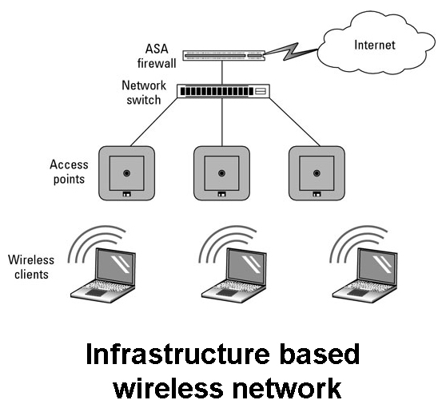
Infrastructure Wireless LANs
Wireless LANs that deploy APs are often referred to as infrastructure wireless LANs.
This "infrastructure" includes both the APs and the wired Ethernet framework that interconnects the APs and a router.

Slide 10
Ad Hoc Network
IEEE 802.11 stations can also group themselves together to form an ad hoc network.
A network with no central control and with no connection to the “outside world”.
The network is formed spontaneously as devices come into proximity.
No preexisting network infrastructure.

Slide 11
Channels and Association
In 802.11, each wireless station needs to associate with an AP before it can send or receive network-layer data.
When a network administrator installs an AP:
the administrator assigns a one or two-word Service Set Identifier (SSID - network name).
The administrator must also assign a channel number to the AP

Slide 12
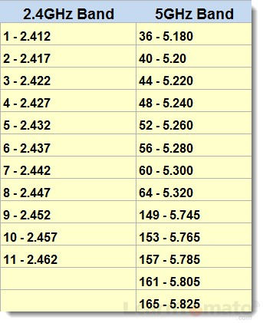
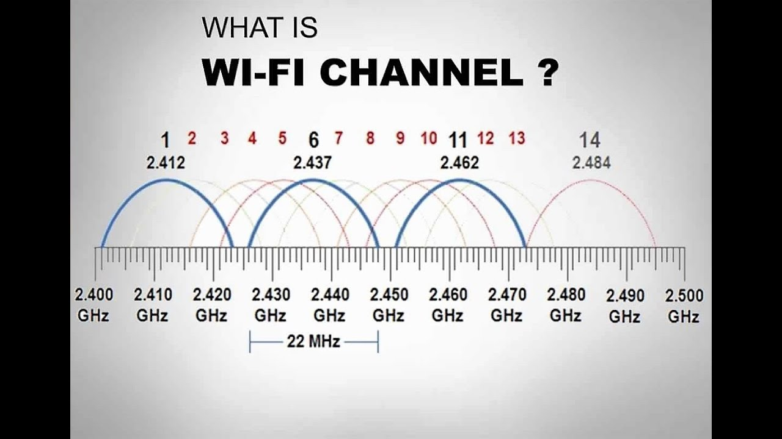
Network Channels, or Wifi Channels:
These are the medium through which your wireless network sends and receives data.
1, 6, and 11 is the set of three non-overlapping channels

Slide 13
WiFi jungle
A WiFi jungle is any physical location where a wireless station receives a sufficiently strong signal from two or more APs
To gain Internet access, your wireless device needs to join exactly one of the subnets and hence needs to associate with exactly one of the APs.
Associating means the wireless device creates a virtual wire between itself and the AP.
But how does your wireless device associate with a particular AP?

Slide 14
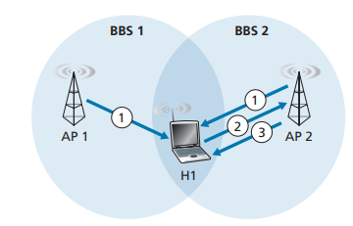
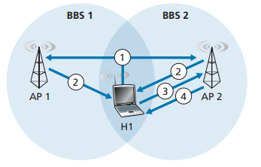
Scanning (Active vs Passive)
Passive Scanning
The process of scanning channels and listening for beacon frames is known as passive scanning.
Active Scanning
A wireless device can also perform active scanning, by broadcasting a probe frame that will be received by all APs within the wireless device’s range.

Slide 15
Passive Scanning
Beacon frames sent from APs
Association Request frame sent:
H1 to selected AP
Association Response frame sent:
Selected AP to H1
Active Scanning
Probe Request frame broadcast from H1
Probes Response frame sent from APs
Association Request frame sent:
H1 to selected AP
Association Response frame sent:
Selected AP to H1

